Slide 1

A case Study of High-Fidelity Web Front end Development for Perishable Goods
Nadira Khan Tabia
ID: 241107

Slide 2
Presentation Outline
Introduction
Literature Review
Limitation of Existing Works
Result Analysis
Problem Statement
Future Enhancements
Objectives
Conclusion

Slide 3
Introduction
In Bangladesh, the current e-commerce platforms for fresh produce do not provide a visually appealing and reliable digital experience.
"Tabia's Vegetables" is the name given to a website that offers fresh and seasonal produce, filling this void.
At its core, the goal is to make online grocery shopping from a tedious task into an enjoyable and user-friendly one.
A combination of cutting-edge frontend technologies and rigorous UI/UX design principles will be employed to achieve this.
Its final product is designed to set an unprecedented standard for niche e-commerce, building customer confidence and improving the digital experience.

Slide 4
Problem Statement
The use of outdated, generic templates by small-scale e-commerce sites in Bangladesh is a major digital disadvantage.
A triple problem arises due to the absence of visually appealing user interfaces, which are not engaging with contemporary consumers.
The absence of interactivity and dynamic features results in a poor and unwieldy user experience.
Also, rigid and unchanging data structures impede the proper presentation and management of products.
As a result, these corporations cannot establish enduring online networks or cultivate loyal customers, even with their top-notch physical offerings.

Slide 5
Objectives
Developed an entirely responsive website structure using semantic HTML5, which is optimized for SEO and provides intuitive user interfaces.
To make their user interface visually engaging and modern by leveraging advanced CSS3 elements such as a dynamic light/dark mode and interactive animations.
A JavaScript data model to scale for complex product information, rendering and filtering of dynamically rich content.
To add the necessary core client side ‘clientside’ e-commerce features, such as persistent shopping cart and fake user authentication, so that users are completely on their way.
In order to ensure a user-friendly and robust experience, they must test the prototype in terms of functionality, cross-browser compatibility, and responsiveness.

Slide 6
Literature Review
It is based on the current "Engagement Phase " in online retail UX, which stresses emotional connections and user experiences.
By adhering to fundamental principles of minimalism, visual hierarchy, and the contemporary glassmorphism aesthetic, it attempts to convey quality while decreasing cognitive load.
Rather than being decorative, it is purposeful animation used to provide functional feedback, guide user attention, and promote the image of a premium brand.
The frontend architecture employs a component-based Model-View-Controller (MVC) pattern in vanilla JavaScript, which ensures that the codebase is dynamic, scalable, and maintains order.
This theoretical framework serves as the foundation for a prototype that seeks to transform the online fresh produce market into an exciting and authentic experience.

Slide 7

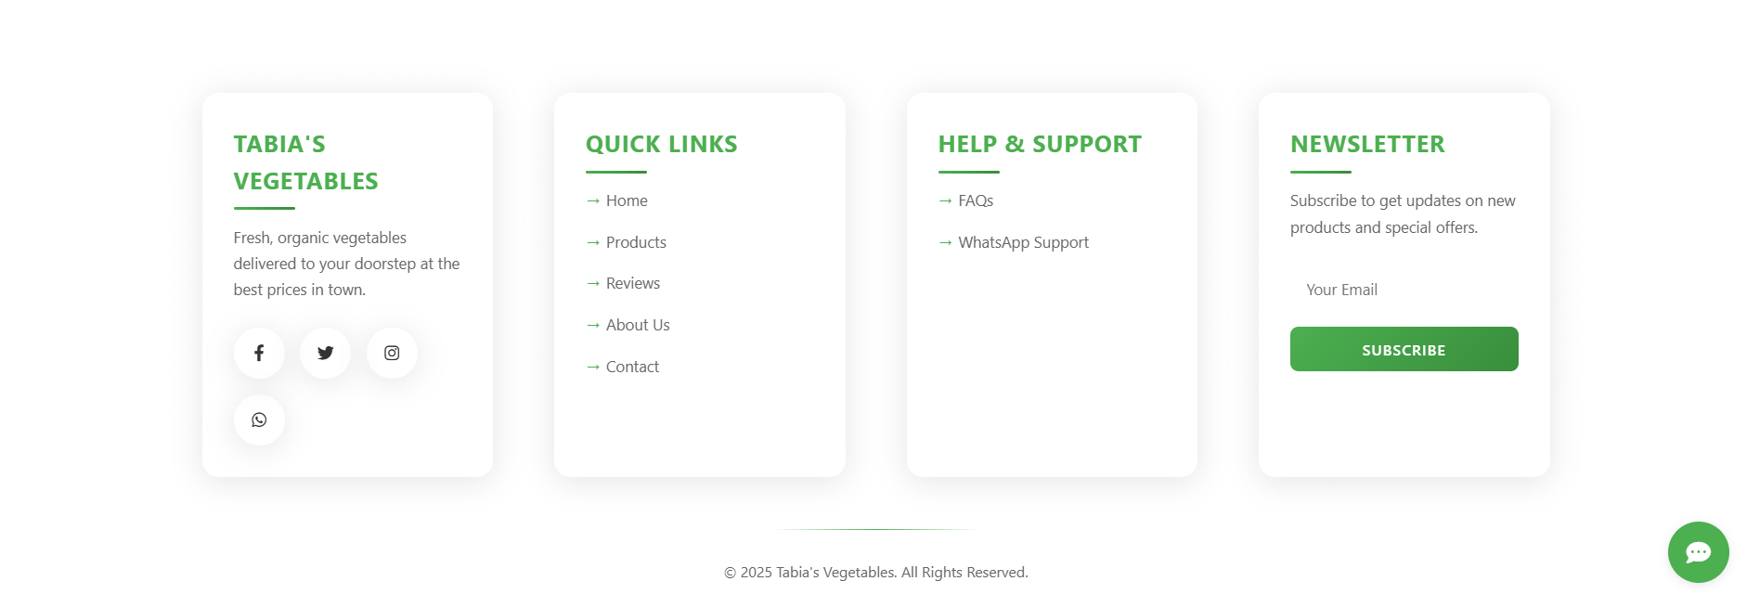
Result Analysis
Header
Footer

Slide 8
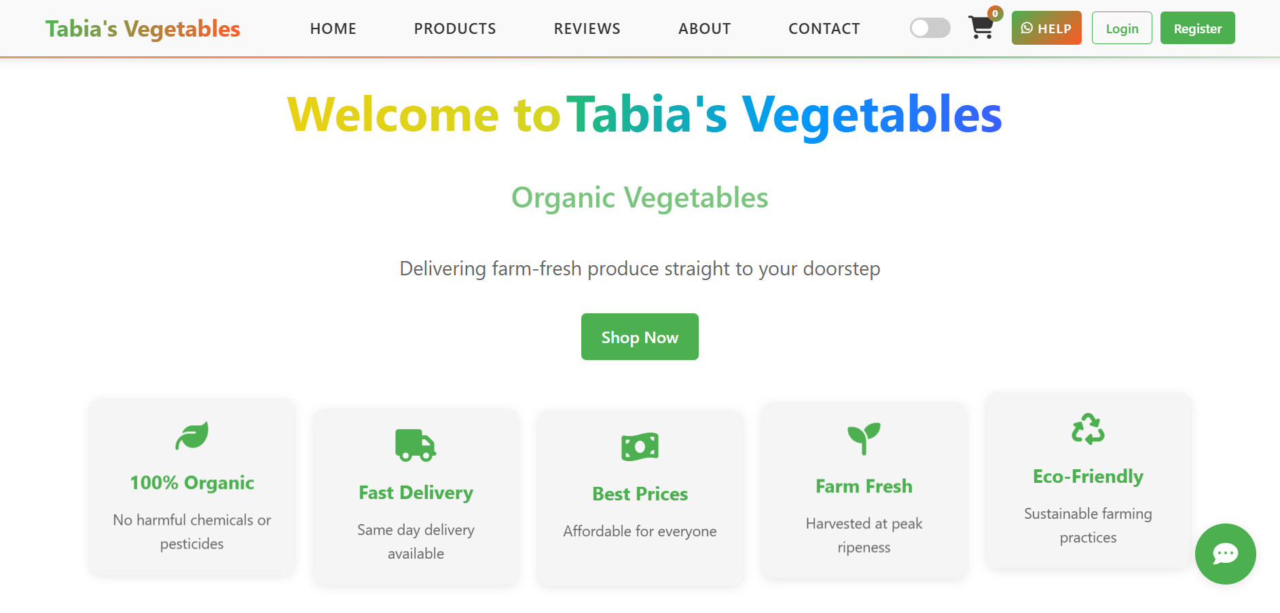
Result Analysis
Homepage

Slide 9
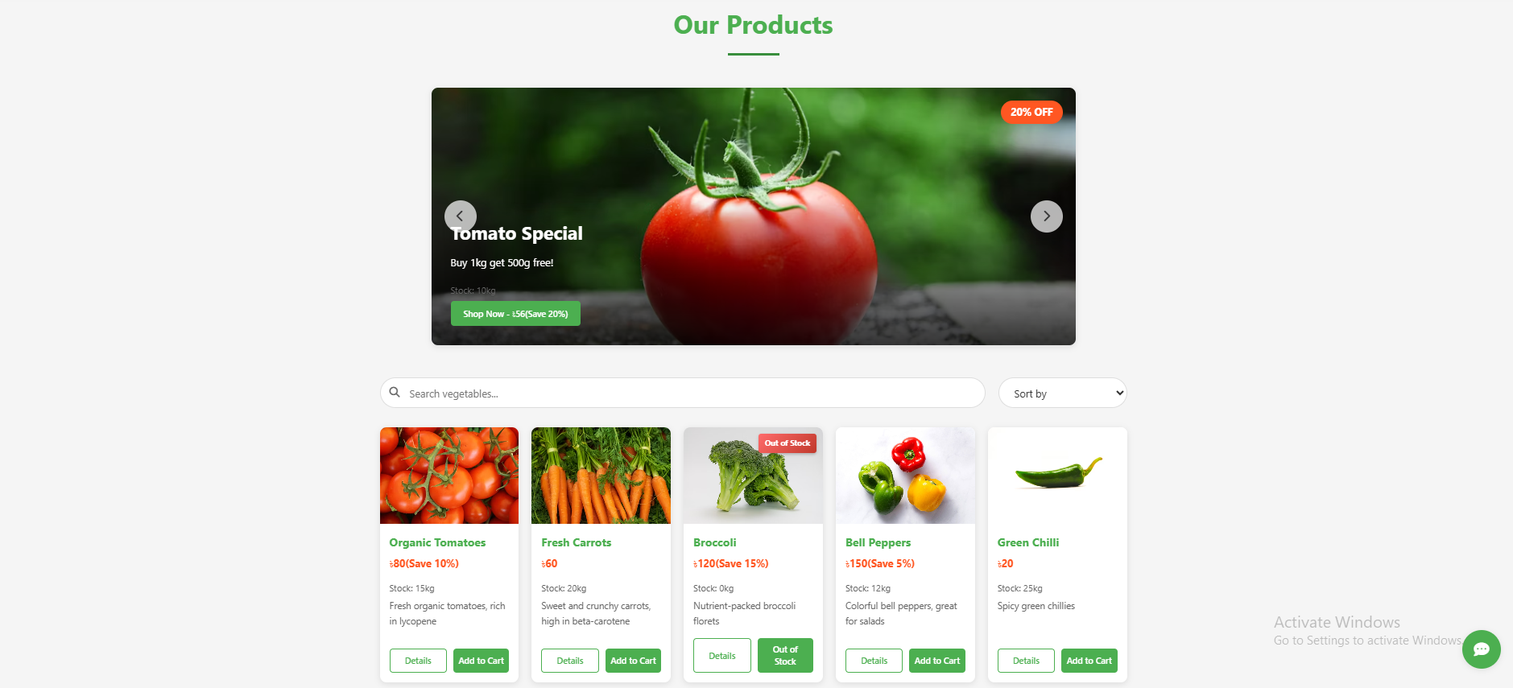
Result Analysis
Products..

Slide 10
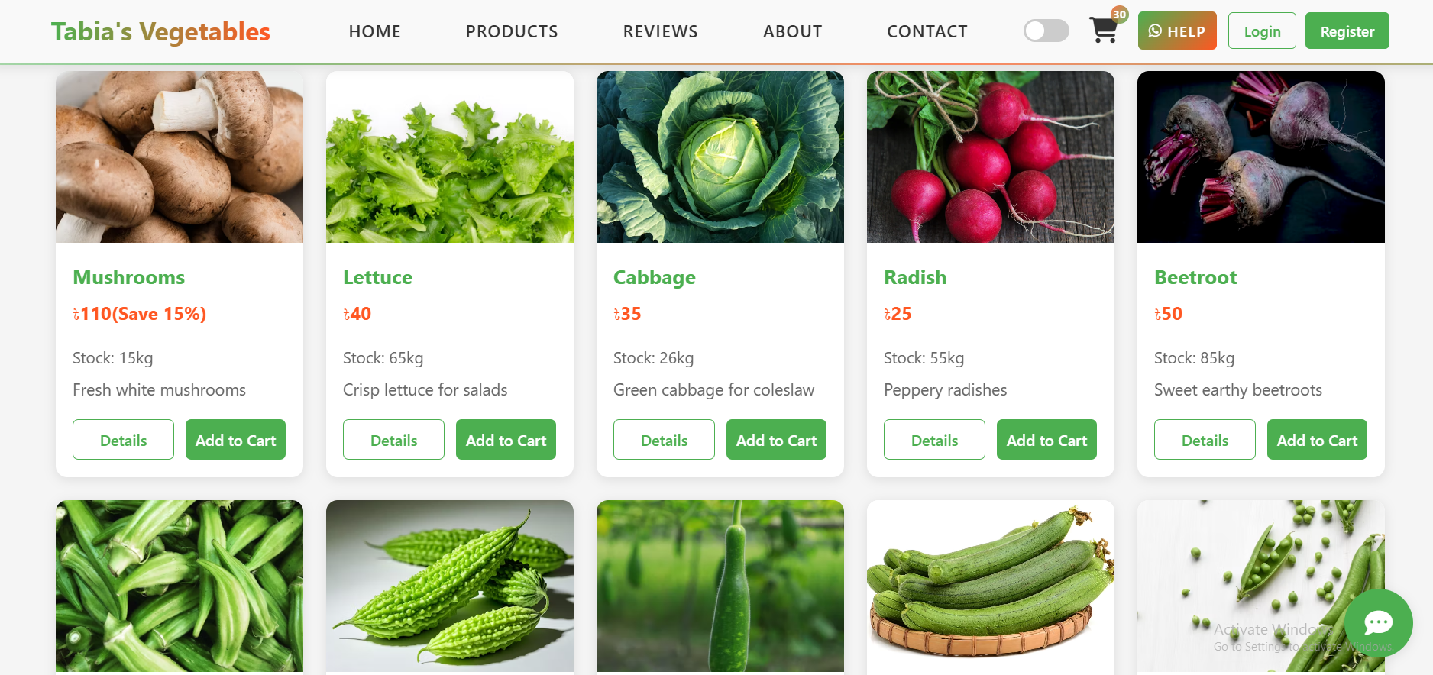
Result Analysis
Products..

Slide 11
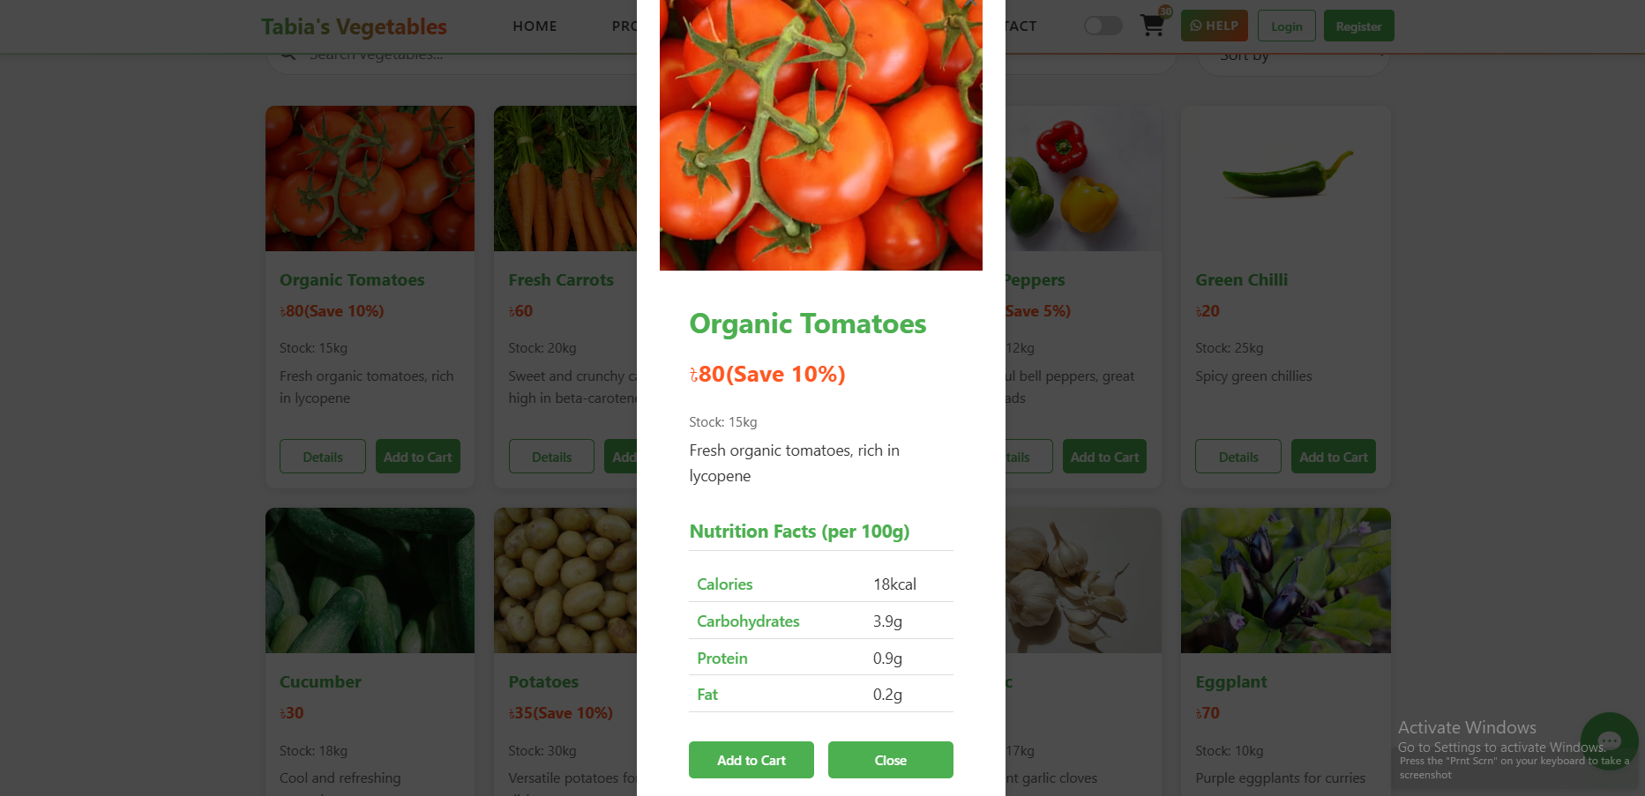
Result Analysis
Products..

Slide 12
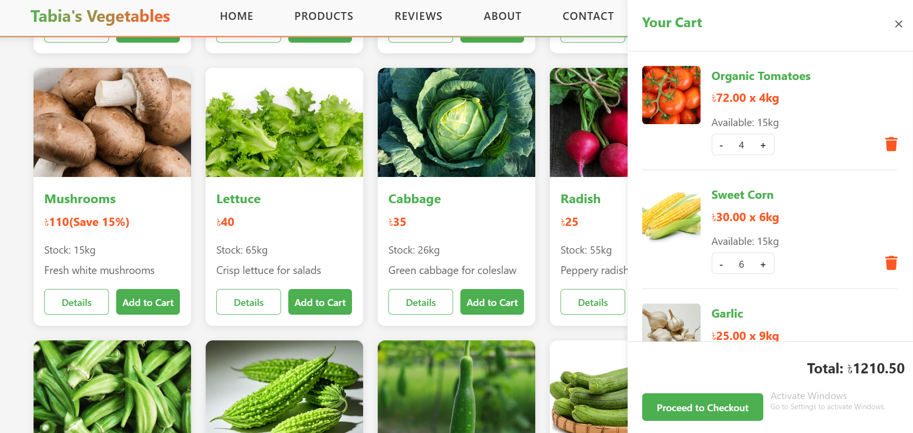
Result Analysis
Products Cart

Slide 13
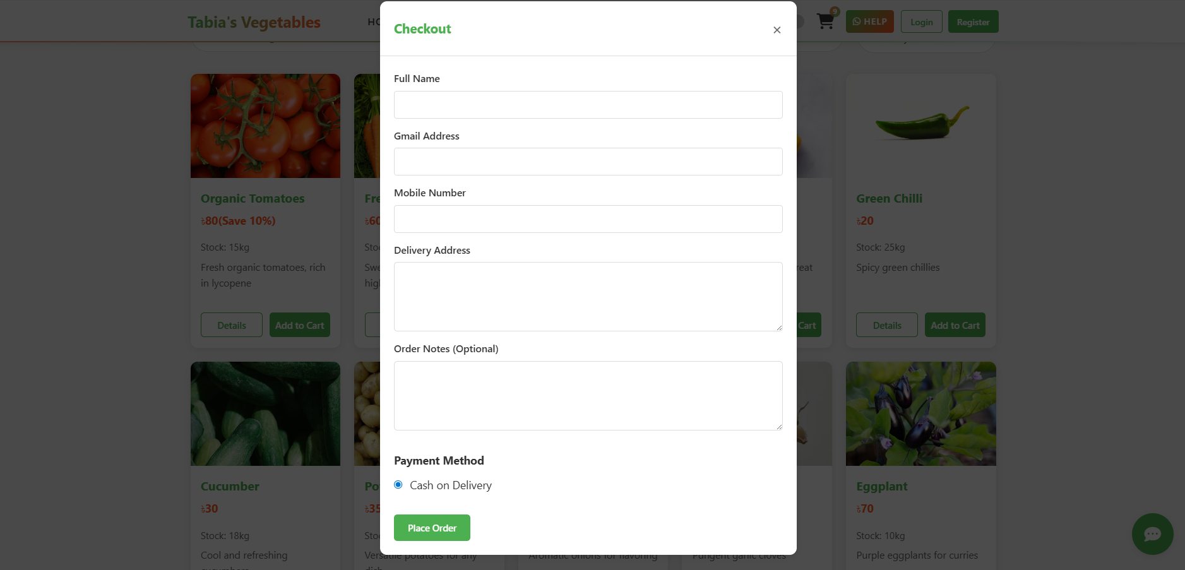
Result Analysis
Product checkout

Slide 14
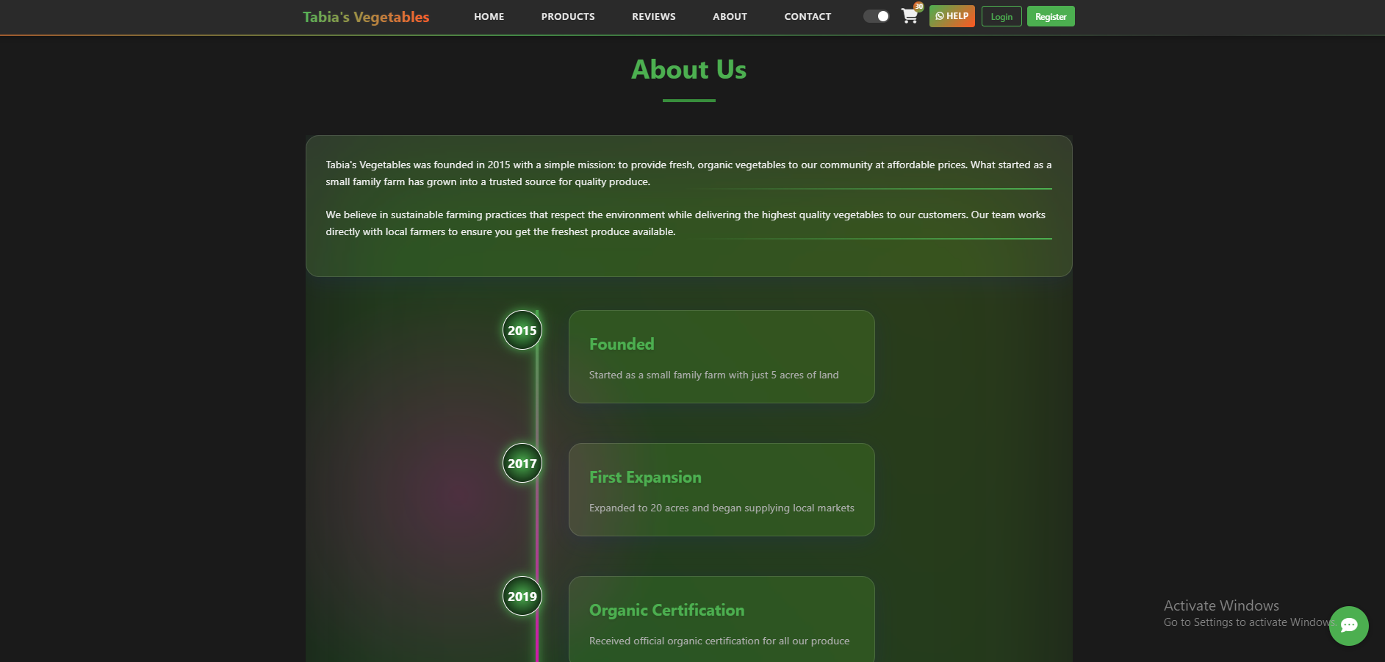
Result Analysis
About

Slide 15
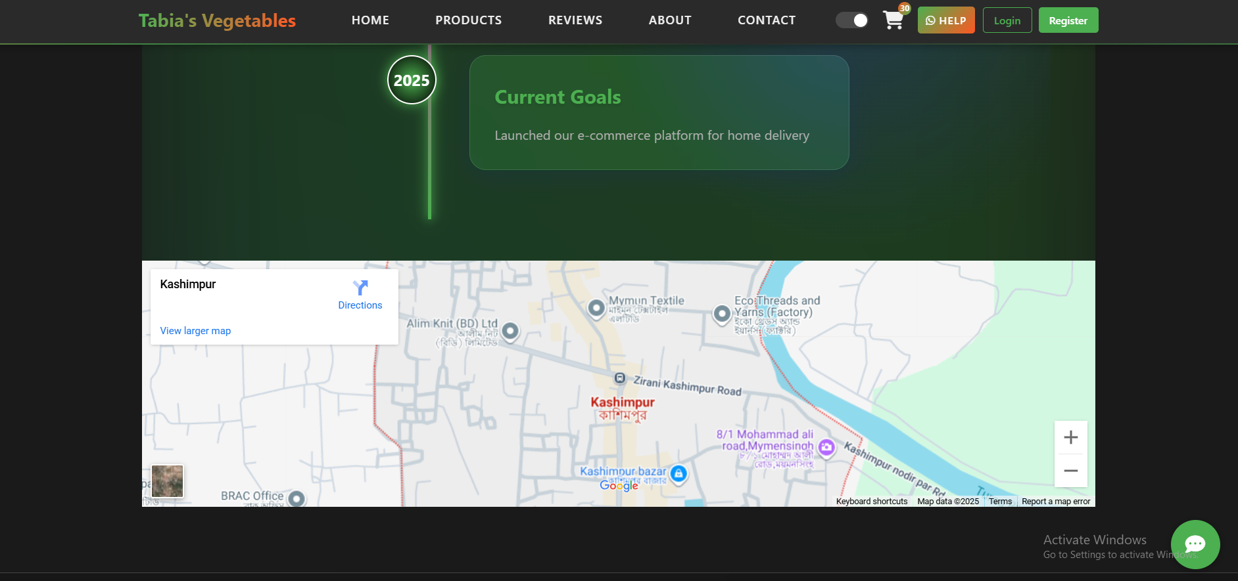
Result Analysis
About

Slide 16
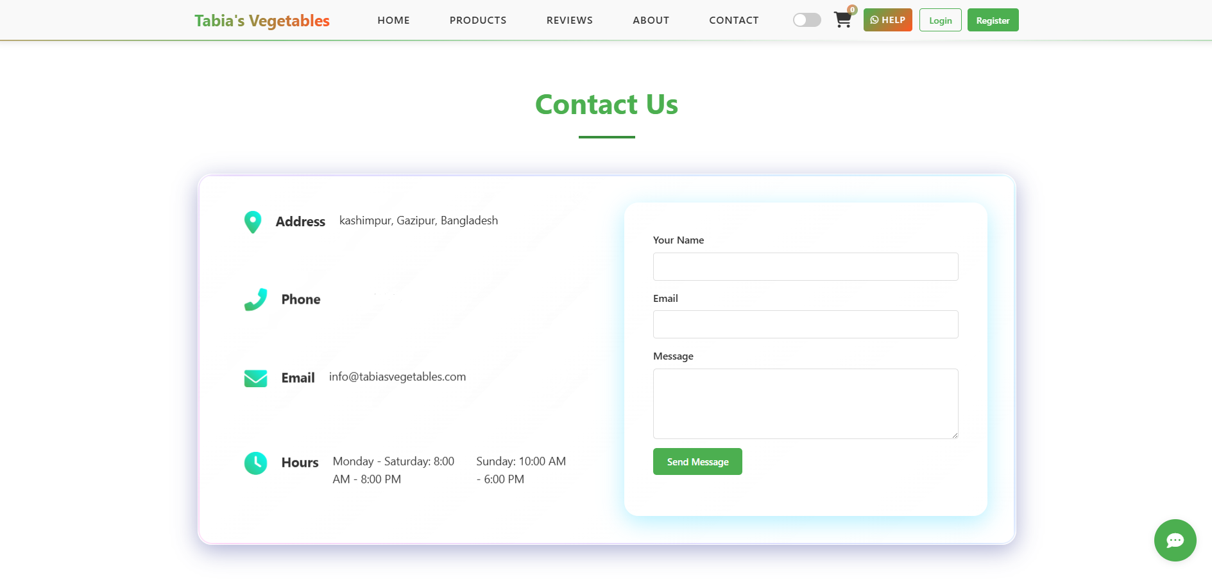
Result Analysis
Contact us

Slide 17
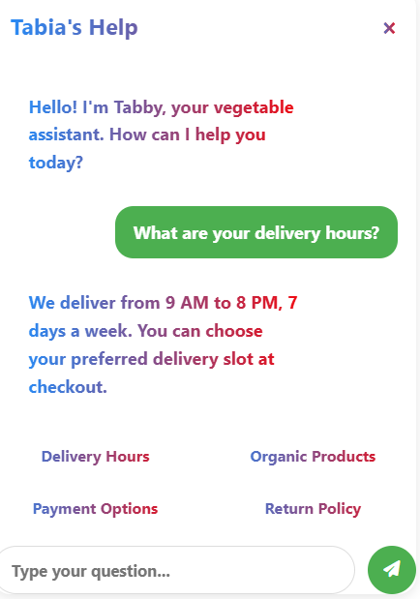
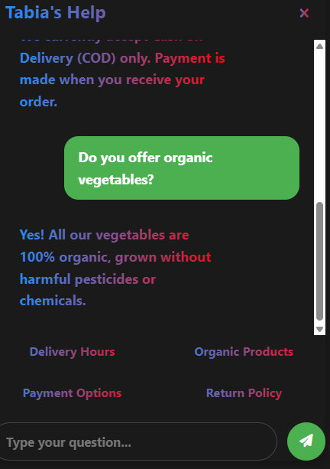
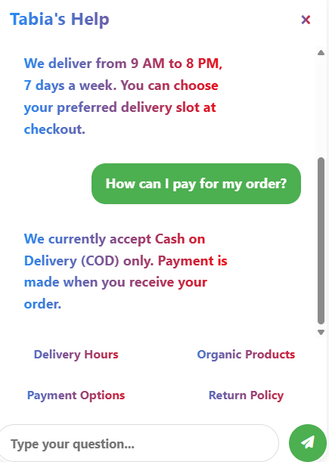
Result Analysis
AI Chatbot

Slide 18
Future Enhancements
Through this project, it is evident that modern frontend technologies (HTML, CSS, JavaScript) can be utilized to build a fully functional prototype for an e-commerce platform in pristine condition.
By incorporating modern design principles like glassmorphism and responsive layout, the end result was an engaging and visually stimulating user experience.
This created a robust and scalable data model for the client side that could handle complex product information, such as inventory and nutritional facts.
By providing an open-source resource for developing niche e-commerce platforms without the need for external frameworks, the project also serves as a useful reference architecture.
The prototype transforms the online fresh produce procurement process from a simple, intuitive and secure platform to an engaging one.

Slide 19
Conclusion
The main improvement is the presence of a strong backend built on Node.js to ensure user authentication, dynamic data handling and server side processing.
The adoption of a modern framework such as React or Vue.js would have measurable advantages in terms of code stability, scalability, and development efficiency when the frontend is switched.
Developing into an operational platform necessitates the utilization of both Stripe and other payment gateway mechanisms.
Enhanced user engagement would be achieved through the inclusion of search functionality, user feedback systems, and personalized product recommendations.
Through formal user experience (UX) testing, A/B testing and interviews will provide information that can be used to refine or optimize.

Slide 20


